Slide 1
Welcome to Band!

Slide 2
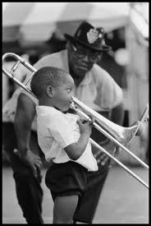
Trombone
Invented about 600 years ago
Brass family, sometimes
called sackbut
Move the slide while blowing
into it to make sound
The big sound of a band comes from the support of trombones
http://www.youtube.com/watch?v=1TRG69ldiHE Kai Winding “Coming Home”

Slide 3
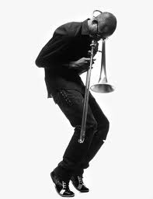
Trombone
To play it well: need to be able
to hear differences in pitches,
need to have good air support
Became really popular through
Jazz music
http://www.youtube.com/watch?v=QxUj2fKFX7A JJ Johnson & Kai Winding “It’s Alright With Me”
http://www.youtube.com/watch?v=hH5KaGxahiU Young girl “All Of Me”

Slide 4
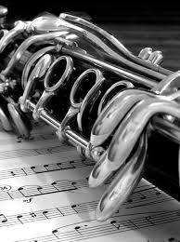
Clarinet
Invented about 400 years ago
Woodwind family, sometimes
called Licorice Whip
Uses a reed that vibrates when
you blow to make sound
Clarinets are the foundation of beginner
bands (they make the band sound
good & are featured in many songs)

Slide 5
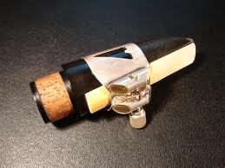
Clarinet
Made from wood (sometimes plastic)
To play it well: need to be able to cover
holes with fingers, need to develop
strong mouth muscles
Popular in many types of music
throughout world
http://www.youtube.com/watch?v=qLTManObB40 Gershwin’s “Rhapsody in Blue”
http://www.youtube.com/watch?v=0jE2g055zRA Benny Goodman “Sweet Georgia Brown”

Slide 6
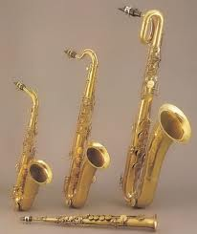
Saxophone
Invented about 170 years ago
Woodwind family, played like
clarinet (with reed & blowing
into mouthpiece)
Made of metal
Provide the middle range sound for bands,
often play both lead parts or background
parts

Slide 7
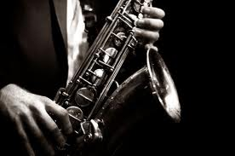
Saxophone
To play it well: need to
develop strong mouth
muscles
Became popular with Jazz music & old school
Rock music
1:27 http://www.youtube.com/watch?v=igFl9OjGQ-o Grace Kelly young sax player
Shuffle Demons “The Funkin’ Pumpkin” http://www.youtube.com/watch?v=imgum0qcPcQ

Slide 8
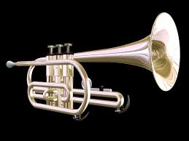
Trumpet
Invented over 3500 years
ago
Brass Family, use valves that are pressed
down & air that is “buzzed” into the
mouthpiece
In ancient times, trumpet playing was a
highly guarded secret & few knew how to
play

Slide 9
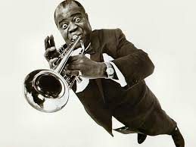
Trumpet
To play it well: need to
blow like you’re
cooling soup & making a little smile at the
same time (soupy smile!)
Trumpets have always been popular & are
played in many music styles
1:00 Louis Armstrong “Hello Dolly” http://www.youtube.com/watch?v=kmfeKUNDDYs
Jackson State Trumpet Fanfare http://www.youtube.com/watch?v=gXBkxv7wXiM

Slide 10
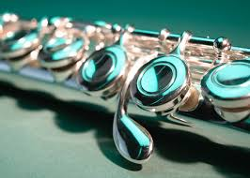
Flute
Invented over 43 000 years
ago, from the time of the earliest humans
in Europe (made of bone or tusks then)
Woodwind family, sometimes called an
aerophone because it has no reed & only
uses blown air to make sounds
Made of metal or wood

Slide 11
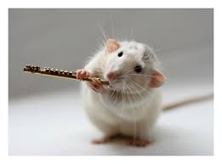
Flute
To play well: need to
blow air like blowing
across a pop bottle to make sound
Many different types of flutes can be found
throughout the world, & they look & sound
very different
Beat boxing flute player http://www.youtube.com/watch?v=5zMmYlzxHs4
Nina Perlove http://www.youtube.com/watch?v=1ZeuverPXEU

Slide 12
What else? What about the other stuff?
If you want to play another instrument, you need to have some extra support outside of class – music lessons. There is so much to learn with the other instruments that there won’t be much time to help those playing other instruments (like drums & guitar).
You need to show me that you are CAPABLE of PLAYING WELL enough to keep up to everyone else!

Slide 13
What makes a band sound good?
A good blend of instruments that work together to make a sound that has enough of high, medium & low sounding parts
Players who PRACTICE (we only sound as good as our weakest player)
People who ENCOURAGE & HELP each other succeed (help the person next to you if they are stuck, don’t give them dirty looks)!

Slide 14
What makes a band sound good?
Starting to play & stopping music TOGETHER
Following teacher STOP SIGNALS so that we don’t waste time waiting for someone to listen (we spend more time playing that way)
PRACTICE (yes again, it is SUPER important)

